Slide 1

Digital Signatures
Digital signatures are a cryptographic technique used in various applications to verify the integrity of digital messages, documents, or transactions. They provide a way to ensure that a message or document has not been manipulated during transmission and that it was created by the claimed sender.

Slide 2

Digital Signatures
First of all when we say signature the first thing you will thinking about is that

Slide 3

Digital Signatures
But why we use the signature from the first place?
Of course, to verify our personality.
So, who to be Shure that is that program or that games or that crack is not manipulated or effected with a malware or virus?
If I want to install a program or a crack so be Shure from the Digital Signatures (hashes).
But who to do that!!!

Slide 4
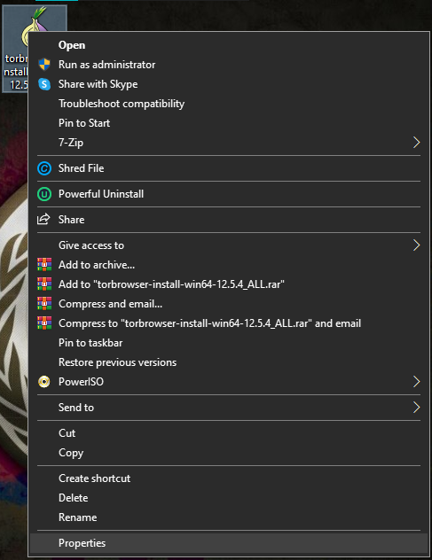
Digital Signatures
Go to the set-up application and right click on it and click on [properties]

Slide 5
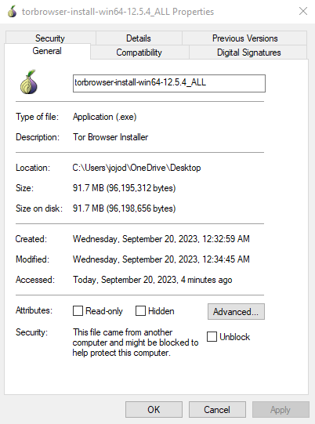
Digital Signatures
Now click on [Digital Signatures]

Slide 6
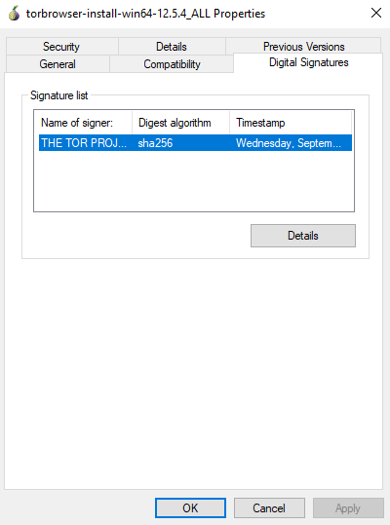
Digital Signatures
Now double click on that

Slide 7
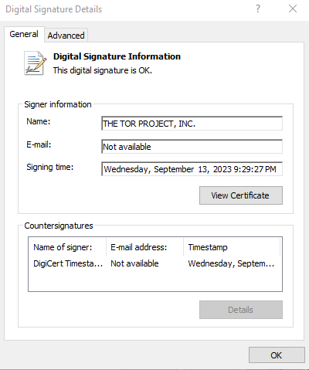
Digital Signatures
Now we can see that the Digital Signature is ok

Slide 8
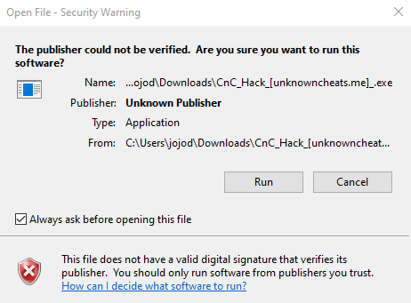
Digital Signatures

Slide 9
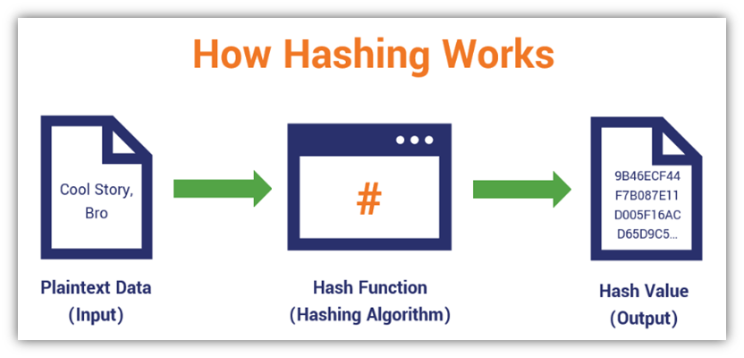
Hash Functions
A hash function is a mathematical function that takes an input and produces a fixed-size string of characters, which is typically a hexadecimal number. The output, often referred to as the hash value and it is a unique representation of the input data. Hash functions are used in computer science and cryptography for various purposes, including data integrity verification, password storage, digital signatures, and more.

Slide 10
Hash Functions
Fixed Output Length: Hash functions produce a fixed-length output, regardless of the size of the input data. For example, the SHA-256 hash function always produces a 256-bit (32-byte) hash value.
Preimage Resistance: It should be mathematically impossible to reverse a hash value and determine the original input. In other words, given a hash value, it should be extremely difficult to find an input that produces that hash.
Commonly used hash functions include the Secure Hash Algorithm (SHA) family (SHA-256, SHA-3) and the Message Digest Algorithm (MD) family (MD5, MD4).

Slide 11

Hash Sum
A hash sum, also known as a hash value or hash code, is a fixed-size numerical or alphanumeric value generated by a hash function from an input data. The purpose of a hash sum is to uniquely represent the input data. Hash functions are designed in such a way that even a small change in the input data results in a significantly different hash sum.
MyHashFunction("Hello, World!") = 1234567890
Even a small change in the input data would result in a significantly different hash sum:
MyHashFunction("Hello, World?") = 9876543210

Slide 12
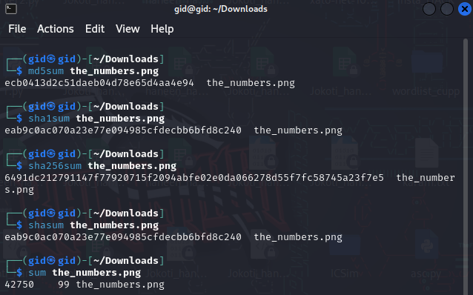
Hash Sum
But how to make Shure from hash sum to an image in Linux?

Slide 13
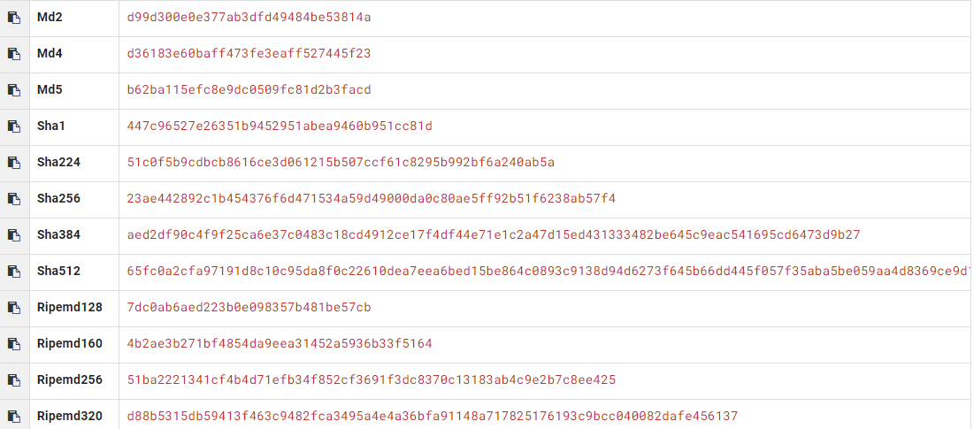
Hash Functions
But how the hash is look like?
Do you know what is that mean? It’s (ASU)

Slide 14
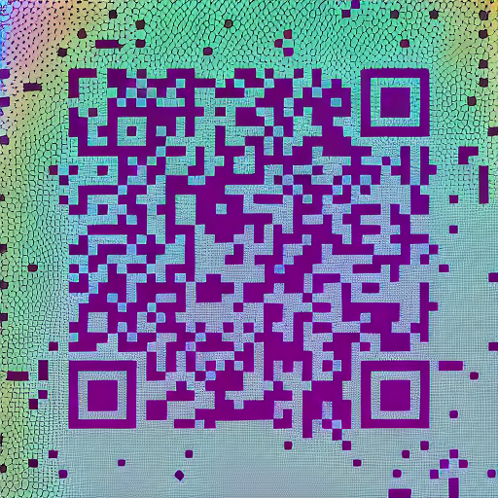
Hash Functions
But how to know the type of hash?
https://hashes.com/en/tools/hash_identifier

Slide 15
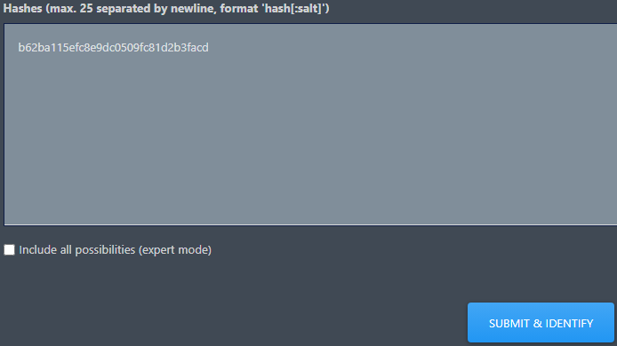

Hash Functions

Slide 16
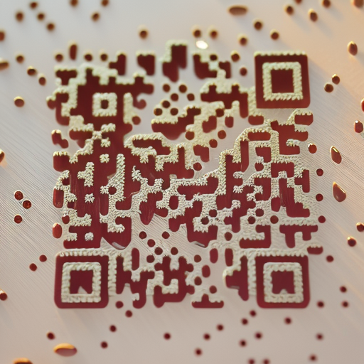

Hash Functions
https://md5decrypt.net/en/
https://md5hashing.net/hash
Now those websites have the biggest data of hashes in the world

Slide 17
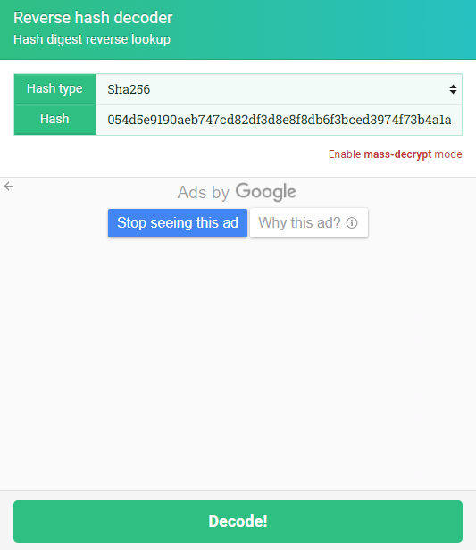
Hash Functions
Now let’s decode that hash

Slide 18
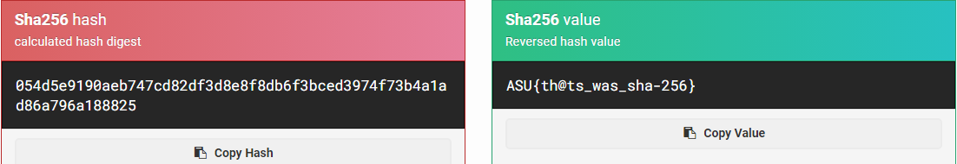
Hash Functions
Here we go!!!

Slide 19
Salt Definition: A salt is a random value added to the input of a hash function to ensure that even identical inputs produce unique hash values. Salts are primarily used to secure passwords against dictionary and rainbow table attacks.
Example of Salt:
Password: mypassword
Salt: random123
Hashed Output: h(mypassword + random123)
Even if someone else uses the same password, their salt will be different, and thus their hash will differ.
Without Salt:
User 1: mypassword → h(mypassword) = abcd1234
User 2: mypassword → h(mypassword) = abcd1234

Slide 20
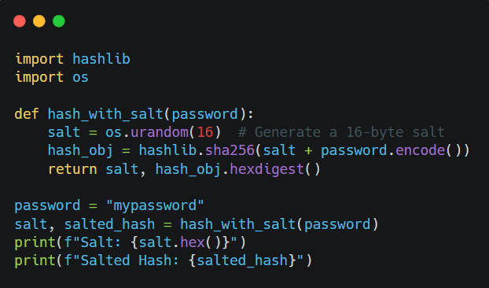
Tools
Example:
Python Scripts: Use Python to demonstrate salting.
rainbow table: is a database containing precomputed hashed outputs for various passwords.

Slide 21
Hash Collisions Definition: A hash collision occurs when two different inputs produce the same hash value using a hash function. This is problematic in security because it can be exploited in attacks like forging digital signatures.
Example of Hash Collision:
Suppose we use a simple hash function: h(x) = x % 10
Input 1: 25 → h(25) = 25 % 10 = 5
Input 2: 35 → h(35) = 35 % 10 = 5
Here, 25 and 35 produce the same hash value 5, which is a collision.
In cryptographic hash functions (MD5 or SHA-1), collisions are less likely but still possible due to mathematical properties.

Slide 22
Real-world & Tools
Real-world Example:
MD5 and SHA-1, once widely used, are now considered insecure because researchers have found methods to generate collisions. For example, the "SHAttered" attack demonstrated a collision for SHA-1.
Tools:
Hash Functions Online: Websites like MD5HashGenerator allow you to input different strings and observe their hash values.
Collision Generators: Tools like HashClash or the hashcat utility can demonstrate how collisions can be generated for weaker hash functions.

Slide 23
Comparing Hash Collisions and Salts
Feature | Hash Collisions | Salt
Purpose | A vulnerability of hash functions | A defense mechanism to strengthen security
Cause | Two inputs produce the same hash | Deliberately adding randomness
Effect | Weakens data integrity and security | Secures against brute-force and rainbow table attacks
Solution | Use strong hash functions like SHA-256 | Always use unique salts per user

